Slide 1
Object Tracking
MeanShift Tracking
CamShift Tracking

Slide 2
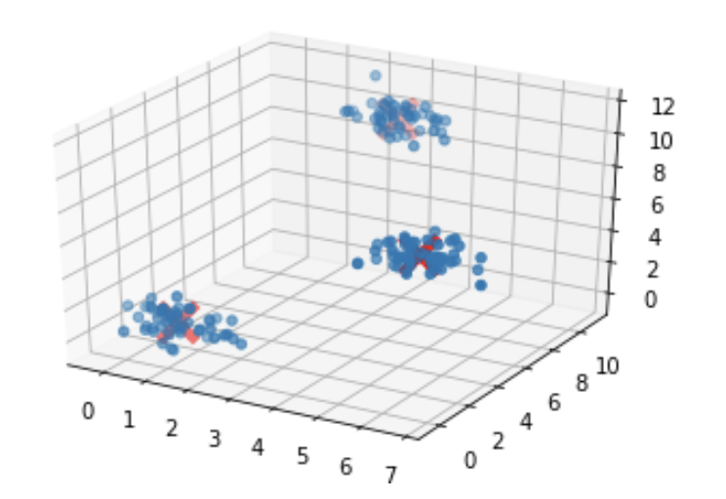
Introduction
The most commonly used methods of Object Tracking that don’t use Deep Learning techniques are MeanShift and CamShift.
MeanShift is the original algorithm and CamShift is an enhancement to this technique. The CAM in CamShift stands for Continuously Adaptive MeanShift.

Slide 3
MeanShift
MeanShift is a clustering algorithm and it uses Kernel Density Estimation (KDE). It uses a weighted function through multiple iterations to identify a centroid in each cluster.

Slide 4
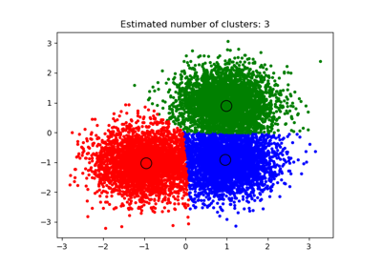
MeanShift
The MeanShift algorithm iteratively shifts each point in the dataset determining the nearest KDE surface peak. The algorithm works by copying the original dataset and freezing the original points. The copied points are shifted against the original frozen points.

Slide 5
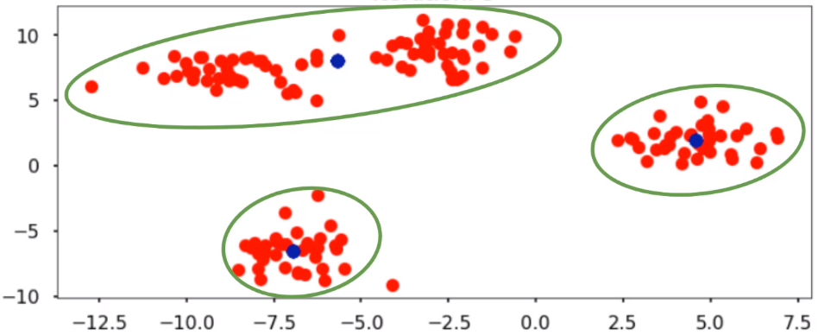
MeanShift
It is not possible to set the number of clusters using MeanShift, it will work this out automatically based on the weighted means. This is different from KMeans as in this algorithm you can manually set the number of ‘k’ clusters.

Slide 6
Demonstration of MeanShift
Read More Here…

Slide 7
CamShift
The main limitation of MeanShift is that the window will remain the same size. This is a problem in video as objects will move from further away to closer and as a result change size.
CAMshift (Continuously Adaptive Meanshift) was the solution to this, published by Gary Bradsky in his paper "Computer Vision Face Tracking for Use in a Perceptual User Interface" in 1998.
The window size and rotation is updated once MeanShift converges and an ellipse is used rather than a rectangle.

Slide 8
Demonstration of CamShift
Read More Here…

Slide 9
Tracking APIs
Even with the improvements of CamShift, it is still not the best solution for performing object detection.
OpenCV allows us to use multiple APIs for performing object detection such as:
Boosting (based on AdaBoost)
MIL (Multiple Instance Learning)
KCF (Kernelised Correlation Filters)
TLD (Tracking, Learning & Detection)
MedianFlow

Slide 10
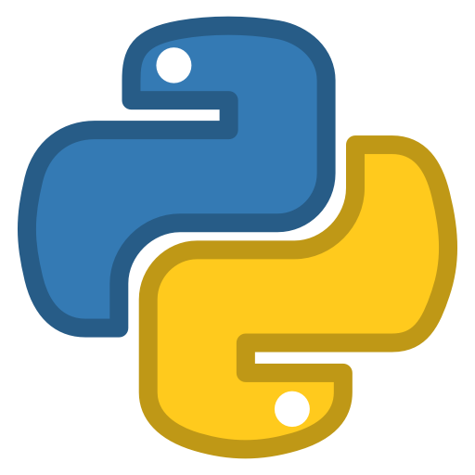

Practical Activities
The practical for today’s class (Week 4c) will explore:
MeanShift
CamShift
In the extension activity you can use each of the Tracking APIs:
Boosting, MIL
KCF, TLD
MedianFlow

